Slide 1
Notes:
Welcome to Relate - a journey of learning how to relate to Jesus.

Slide 2
Notes:
I have a friend, Edgar, who happens to also be a pastor - what are the things that he and I can do we develop our relationship?

Slide 3
Notes:
So how do we develop a relationship with Jesus?

Slide 4
Notes:
1. Read what God has written

Slide 5
Notes:
SOAP is a structure you can use for your daily devotions:
* Scripture – read a passage slowly and look for a thought that you connect with.
* Observation – ask what it means, write it out in your own words.
* Application – ask how it relates to your life and write down your thoughts.
* Prayer – write out a prayer to God and ask him you help you grow in the truth.

Slide 6
Notes:
Activity: Read through Psalm 32:1-5 using the SOAP approach to relate to Jesus.

Slide 7
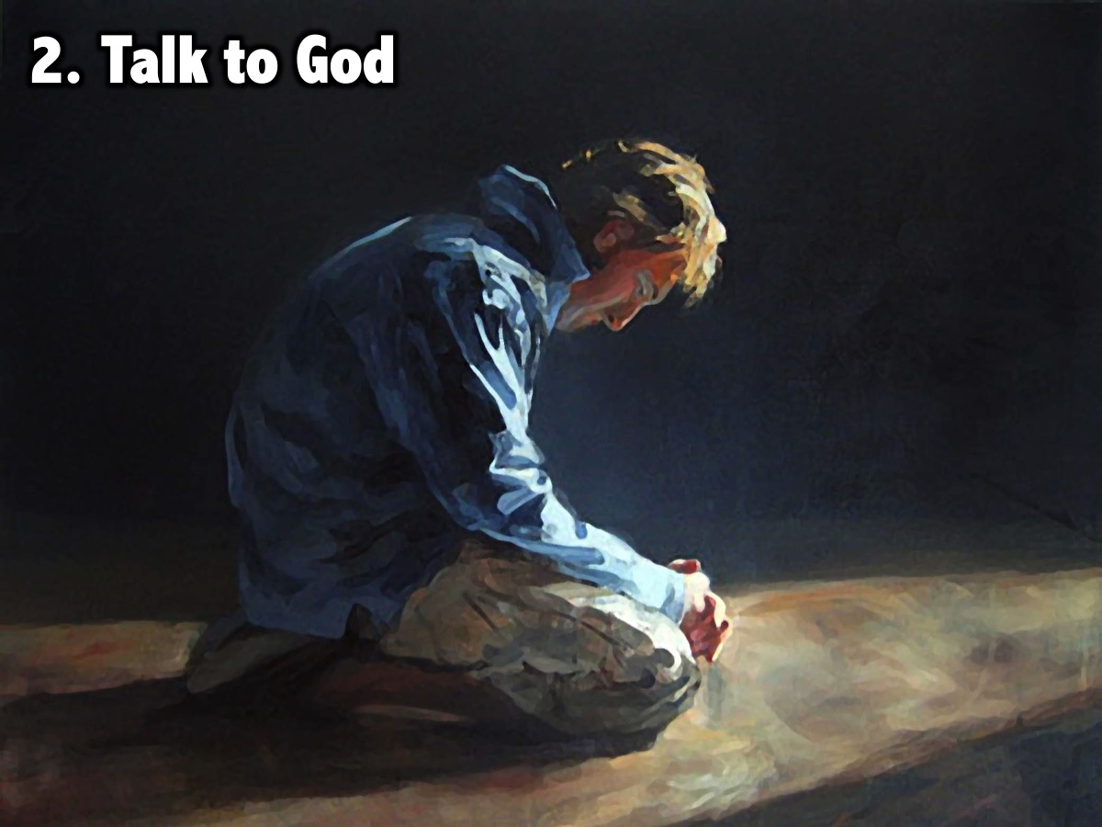
Notes:
2. Talk to God

Slide 8
Notes:
Learning How to Pray: If prayer is new to you, you can start by writing a letter to God and then reading it to Him. The following headings can be used:
1. Adoration - I love you because…
2. Confession - I am sorry for…
3. Thanksgiving - Thank you for…
4. Supplication - Please help me…

Slide 9
Notes:
3. Be with God’s friends

Slide 10
Notes:
Select two “One Another” commands from this list and do them to someone in the group:
* Serve one another
* Be kind to one another
* Forgive one another
* Teach one another
* Encourage one another
* Spur one another to good deeds
* Confess your sins to one another
* Pray for one another

Slide 11
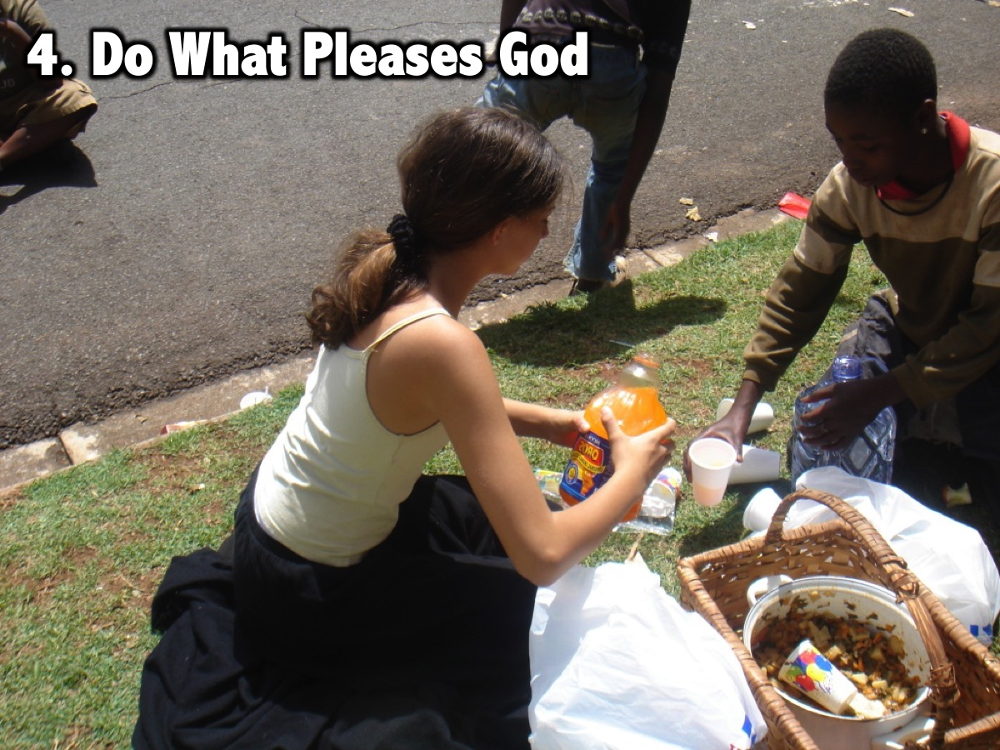
Notes:
4. Do what pleases God

Slide 12
Notes:
Here are some ways in which we can please God:
* Be baptised in water: if you have not been water baptised then find a leader and talk to them about it.
* Get filled by the Holy Spirit: if you have not been filled then find a leader and talk to them about it.
* Let Jesus be the boss of your life: If there is an area of your life that Jesus does not control and surrender it.
* Confess your sins: Think of a sin you have not confessed and ask God to forgive you.

Slide 13
Notes:
Station #5: Talk about your relationship

Slide 14
Notes:
A. Write out the story of how you got saved:
(1) What was your life like before you met Jesus?
(2) How did you give your life to Jesus?
(3) How has Jesus changed your life?
B. Who can you share your story with this week?

Slide 15
Notes:
Closing Prayer:

